Slide 1





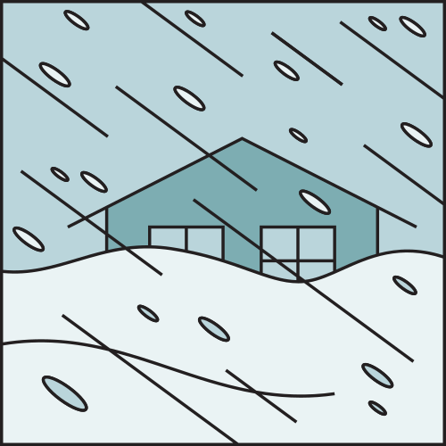

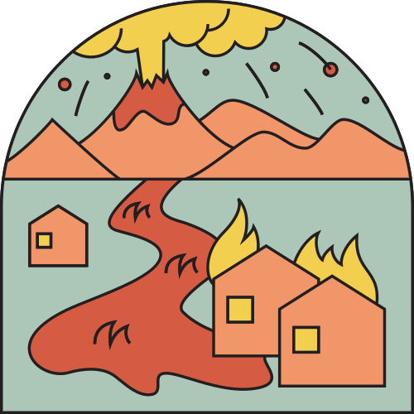

DISASTER
prediction
and
Response

Slide 2
TENSOR TITANS
Vaibhav M N
Hema Kumpatla
Ritansh Shrivastava

Slide 3
Problem statement
Predicting the occurrence and severity of disaster events using data-driven techniques.

Slide 4
Types of Hazards
The United States outlines the following 18 Natural Hazards:
Avalanche
Coastal Flooding
Cold Wave
Drought
Earthquake
Hail
Heatwave
Hurricane
Ice Storm
Landslide
Lightning
Riverine Flooding
Strong Wind
Tornado
Tsunami
Volcanic Activity
Wildfire
Winter Weather

Slide 5
Categories
Geophysical
Hydrological
Meteorological
Climatological
Earthquakes
Volcanic Activity
Flooding
Landslides
Tsunamis
Avalanche
Heat Waves
Cold Waves
Hurricanes
Hails
Winter Storms
Lightning
Winds
Tornados
Drought
Wildfire

Slide 6

AGenda:
Minimizing the Effect
The disaster effect can be minimized by predicting disaster occurrence probability, affected areas and the severity.

Slide 7
“In the United States, the National Weather Service provides forecasts and alerts to protect communities.”

Slide 8
STEPS taken
Exploratory Data Analysis (EDA)
Data
Collection
Important features like location, date, and weather patterns.
Preprocessing Steps:
Data cleaning for missing values and inconsistencies.
Feature engineering to enhance model performance.
Normalization or scaling for feature uniformity.
Visualizations and insights on disaster frequency trends and geographic distributions.
Identification of patterns relevant to disaster prediction.

Slide 9
STEPS taken
Model Selection and Development
Evaluation Metrics
Important features like location, date, and weather patterns.
Preprocessing Steps:
Data cleaning for missing values and inconsistencies.
Feature engineering to enhance model performance.
Normalization or scaling for feature uniformity.
Metrics Used: Choose metrics like accuracy, precision, recall, F1-score, and AUC-ROC.
Model Performance: Model results based on these metrics.
Insights: Key strengths and areas for improvement based on evaluation.

Slide 10
STEPS taken
Challenges Faced
Future Enhancements
Data Limitations: Issues like missing data, class imbalance, and lack of detailed geographic data.
Computational Constraints: Training time and memory challenges for complex models.
Predictive Accuracy: Trade-offs in balancing precision and recall.
Real-Time Data Integration: Plans to incorporate real-time data from weather services and social media.
Advanced Models: Potential use of deep learning models like LSTMs or CNNs for time-series predictions.
Improved Data Sources: Aim to integrate granular geographic and socioeconomic data for better accuracy.

Slide 11
conclusion
Project Impact
Impact on Preparedness: Support for disaster preparedness, reduced response times, and potential to save lives and resources.
Applications & Partnerships: Real-world use cases and potential collaborations to amplify impact.
Open for questions from the jury..

Slide 12
THAnk you
“It is important that you are prepared for potential disasters depending on your location.”

